Slide 1
IT2311- Rapid Application Development
Week 01 - Practical

Slide 2
Objectives
Identify visual Basic environment
Identify Tools in Tool Box
Identify Properties for each tool in tool box

Slide 3
Visual Basic.NET
Included in Visual Studio.NET
Visual Basic (can also be purchased separately)
C++
C#
.NET Framework
Complete rewrite from VB Version 6

Slide 4
Visual Studio.NET Editions
Academic
Professional
Enterprise Developer
Enterprise Architect

Slide 5
Steps for Writing VB Projects
Design/Define the User Interface
Plan/Set the Properties
Plan/Write the Code
Test and Debug

Slide 6
VB Application Files
One Solution File .sln
Solution User Options File .suo
Project Files .vbproj
Project User Options File .vbproj.user
Form Files .vb
Resource File for the Form .resx

Slide 7
Visual Studio Environment
Integrated Development Environment (IDE)
Form Designer
Editor for entering code
Compiler
Debugger
Object Browser

Slide 8
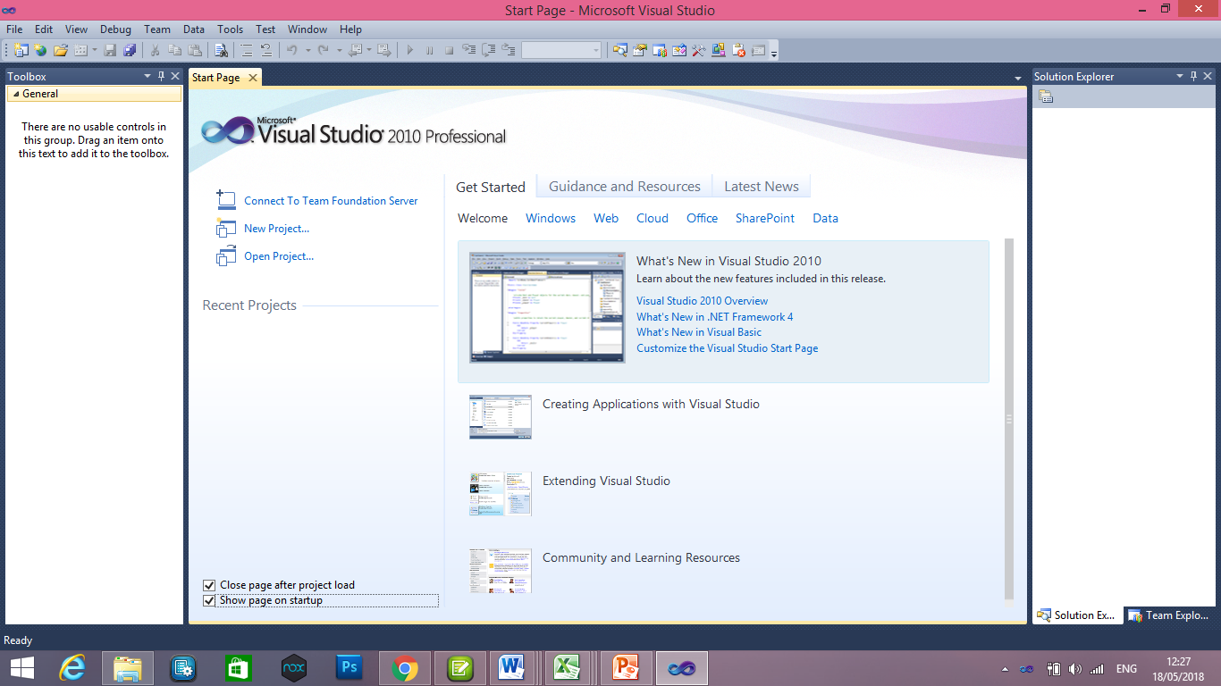
Visual Studio IDE Start Page

Slide 9
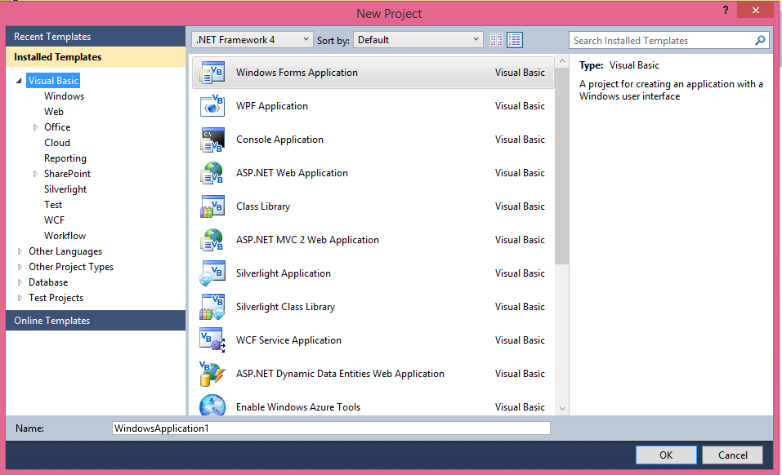
IDE New Project Dialog

Slide 10
IDE Main Window
Toolbars
Document Window
Form Designer
Solution Explorer
Properties Window
Toolbox

Slide 11
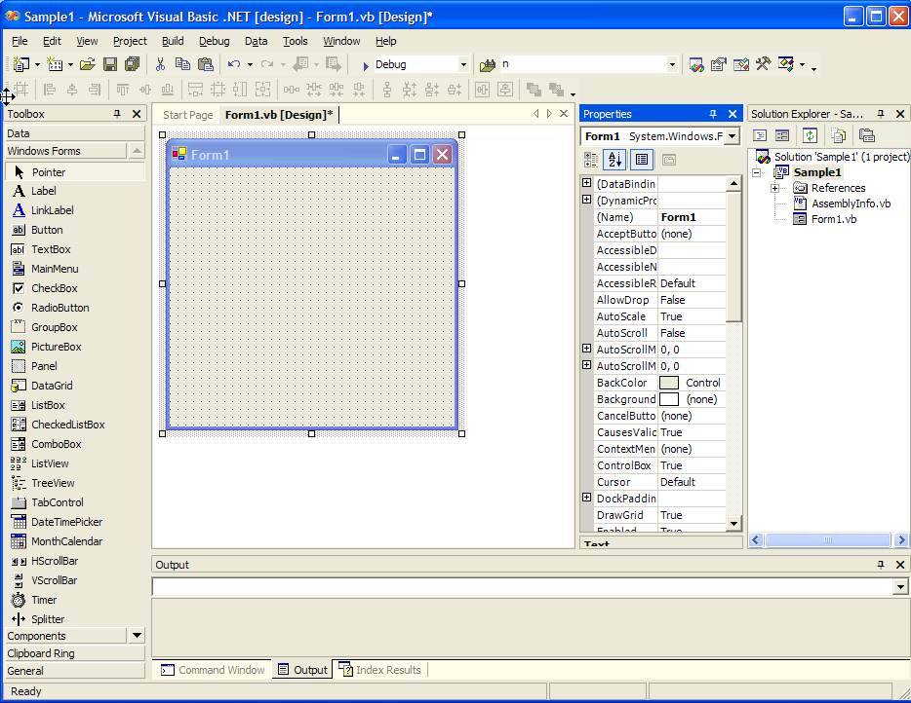
IDE Main Window
Design Window
Solution
Explorer
Toolbox
Properties
Window

Slide 12
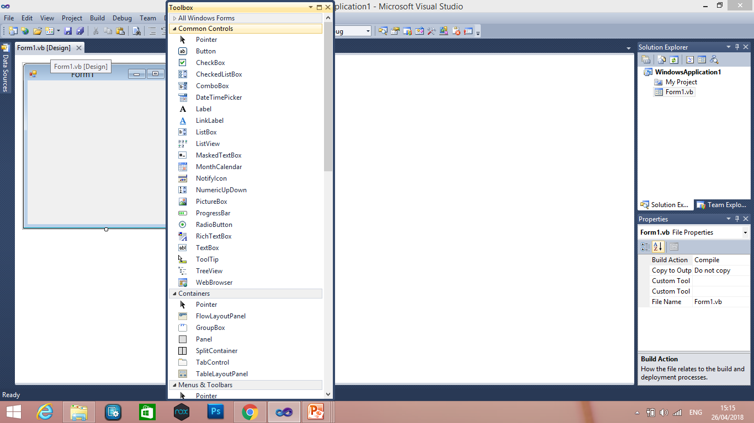
VB Toolbox
Holds the tools you place on a form

Slide 13
Visual Studio Help
Extensive Help feature
Includes Microsoft Developer Network library (MSDN)
Entire reference manual
Coding examples

Slide 14
Modes
Design Time--used when designing the user interface and writing code
Run Time--used when testing and running a project
Break Time--if/when receiving a run-time error or pause error
“Look at the Title Bar”

Slide 15
Naming Rules
Always use standard names for objects
No spaces or punctuation marks
3 letter lowercase prefix identifies control type
Button-btn
Label-lbl
Form-frm
If multiple words capitalize 1st letter of each word

Slide 16
Recommended Naming Conventions for VB Objects
Object Class Prefix Example
Form frm frmDataEntry
Button btn btnExit
TextBox txt txtPaymentAmount
Label lbl lblTotal
Radio Button rad radBold
CheckBox chk chkPrintSummary
Horizontal ScrollBar hsb hsbRate
Vertical ScrollBar vsb vsbTemperature
PictureBox pic picLandscape
ComboBox cbo cboBookList
ListBox lst lstIndegredients

Slide 17
Identifying Tools in Tool Box
Placing a Label Control on the Form
Step 1: Select the label control by clicking on the icon for the Label control
Step 2: Place the label in the desired position on the form
Step 3: Release the mouse button, thereby completely specifying the location, width, and height of the text box.
Step 4: Make sure that your Label control is roughly the same size as shown. If it is not, there are two ways that you can modify your control.
You can adjust it visually.
You can adjust it by modifying properties of the Label control. The Width and Height properties can be set to the exact values. Set yours to 248, 40, respectively.
Step 5: Set the Name property of the Label to lblTitle.
Step 6: Click the Text property and type HNDIT 2nd Year.

Slide 18
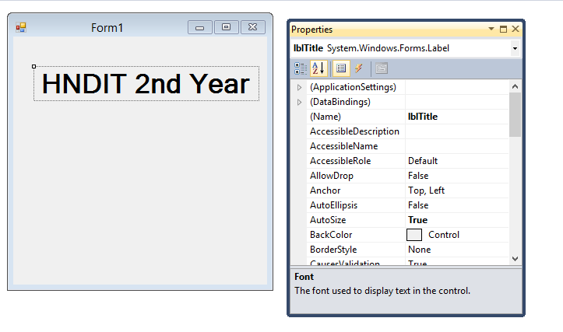
Label

Slide 19
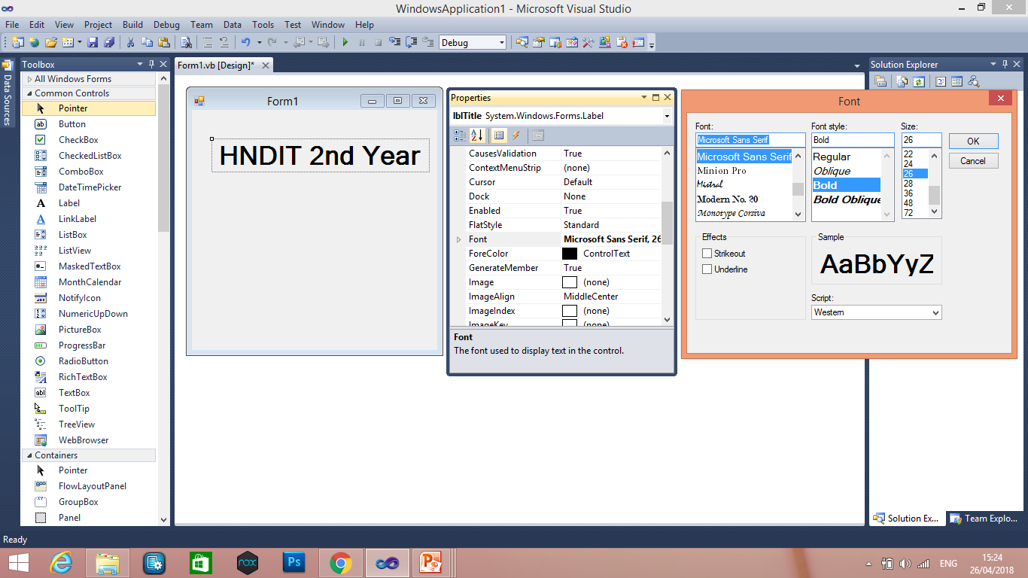
Changing the Label Size and Style
Step 7: We can set a font’s type face, size, and style.
Set the Font.Style to Bold and the Size to 26.

Slide 20
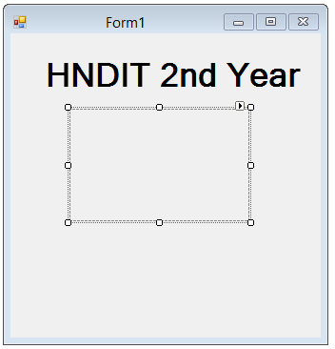
Picture Box Control
Step 1: Visual Basic allows you to easily add pictures to your form. In your case, you wish to add a picture of a door twice. To display a picture, you will use the picture box control.
Step 2: Click just below and to the left of the text in the Label control you previously placed.
Hold the mouse button down and release it with the mouse pointer near the bottom of the form and aligned in between the o’s of the word “Door” in the label control.

Slide 21
Setting the Name of the Control
Step 3: Set the Name property of the PictureBox to picSLIATE.
Setting the Picture to Display in the Control
Step 4: Click on the Image property
Click on the ellipses (…) and a dialog box will appear to select the graphic file to display within the PictureBox control.
Resizing the Picture Box Control
Step 5: Since the form is not large enough, increase its size by setting the Width and Height to 624, 424, respectively. Click anywhere on the form a control is not already placed to select the form and display its properties.
Increase the size of the PictureBox by setting the Height and Width properties to 100, 248, respectively.

Slide 22
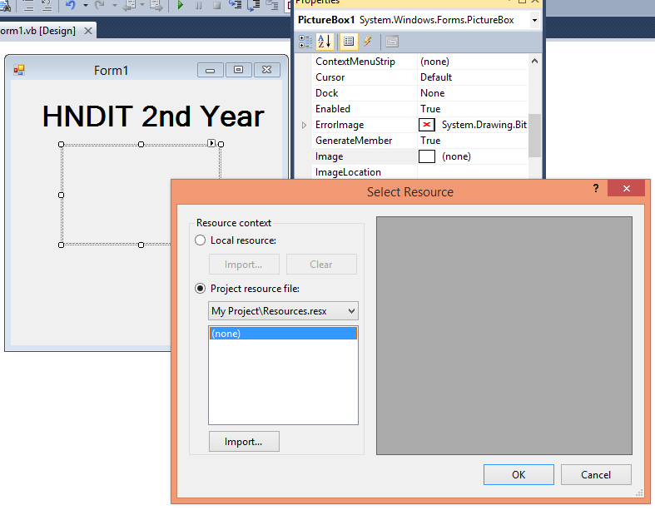

Slide 23
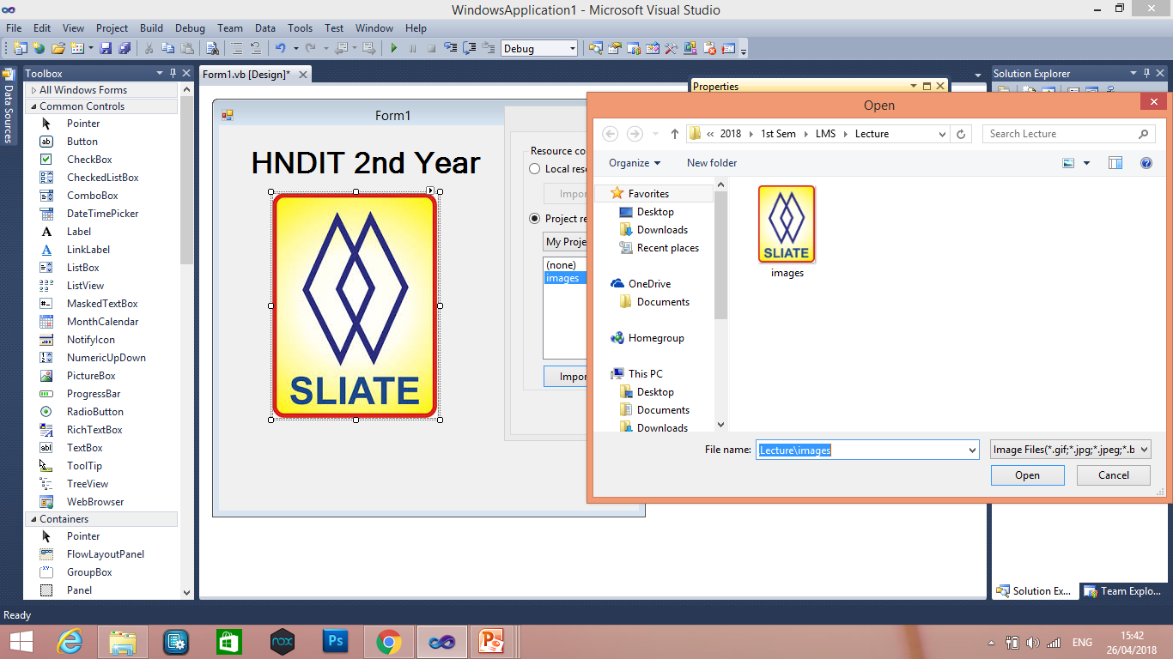

Slide 24
Text Box Control
By using a text box control you can place an area on the form where users of the application may enter any text he or she wishes. Select the Text Box From the Control Toolbox
Step 1: Select the TextBox control from the control toolbox.
Add Text Box to Form
Step 2: Place a text box on the form in the same manner as the other controls
Setting the Name of the Control
Step 3: Set the Name property of the text box to txtName .
Clearing the Default Text
Step 4: Click on the Text property and erase "TextBox1".

Slide 25
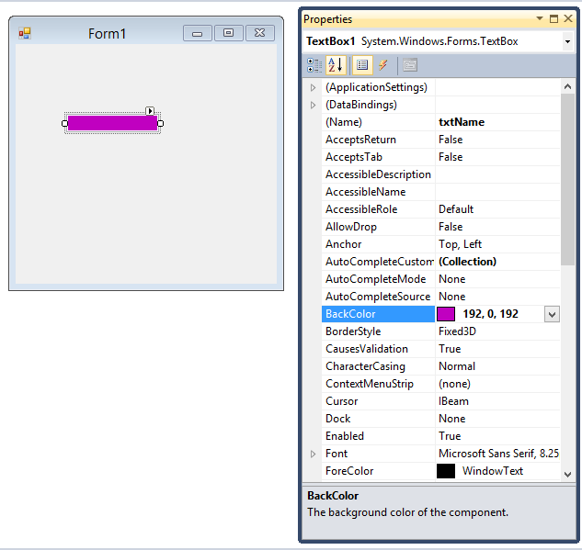

Slide 26
Button Control
By using a Button control you can place an Command Button on the form where users of the application may enter any Command
Select the Button From the Control Toolbox
Step 1: Select the Button control from the control toolbox.
Add Button to Form
Step 2: Place a Button on the form in the same manner as the other controls
Setting the Name of the Control
Step 3: Set the Name property of the Button to btnClick.
Step 4: Click the Text property and type HNDIT 2nd Year. .

Slide 27
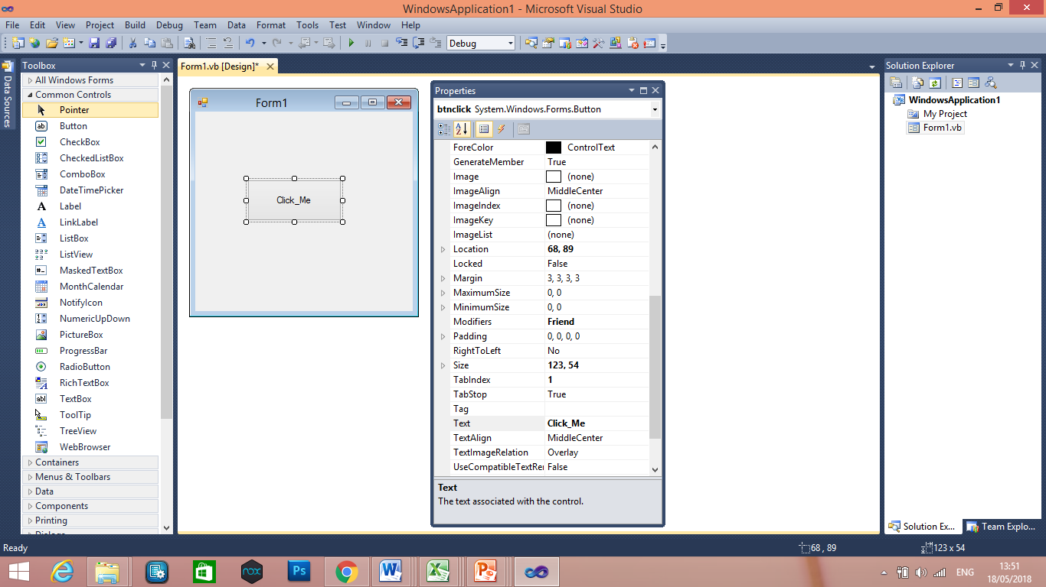

Slide 28
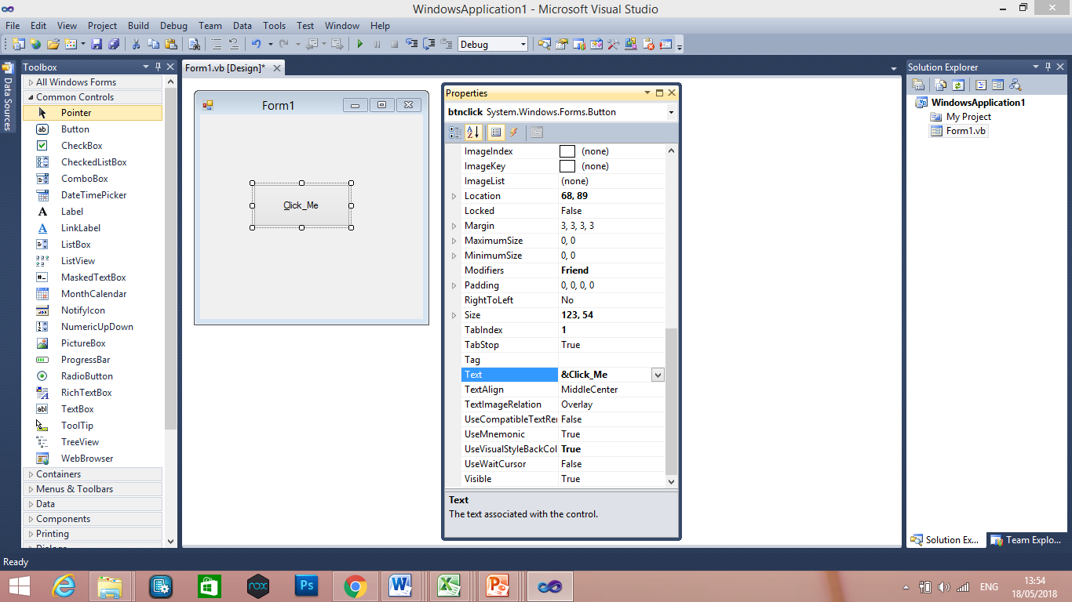
Add an Access Key

Slide 29
Auto Hide
Hides Toolbox when not in use
Vertical push pin icon indicates auto hide is disabled.
Click the push pin to make it horizontal and enable auto hide.
push pin

Slide 30
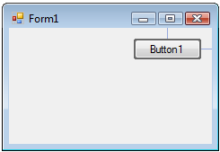
Positioning Controls
proximity line

Slide 31
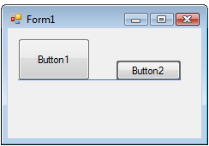
Aligning Bottoms of Controls
snap line

Slide 32
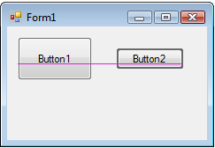
Aligning Middles of Controls
snap line

Slide 33
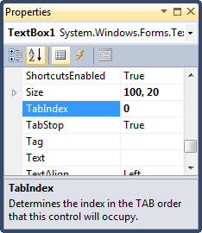
Tab Order
The tab indices determine the order in which controls receive the focus during tabbing.
The control whose TabIndex property is set to 0 has the focus when the program begins.
Notes:
Tab index determines the order in which the control receives the focus while tabbing.
Setting of tab order invoked from Edit window.

Slide 34
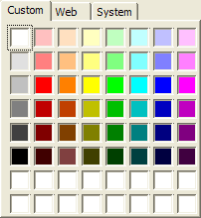
Changing Color
The two properties that were used in this example are ForeColor and BackColor. Each can be set interactively or programmatically. To set the color interactively, perform the following:
Step 1: Click on the control that you wish to change the color of.
Step 2: Click on the property you wish to change. (ForeColor or BackColor).
Step 3: Click on the drop-down arrow to get the Pallet window to appear.
Step 4: Click on the Custom tab of the pop-up window.
Step 5: Click on the color you wish to select:

Slide 35
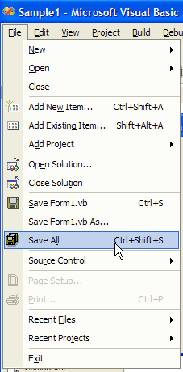
Save the Project
Make sure to save your work
SAVE ALL (not Save Form)
Visual Basic applications are
made of several files -
Often even several forms

Slide 36
Get full idea about IDE
Work out with all the tools in tool box
Identify properties for each tool in tool box

Slide 37
Create an interface with followings,
Four Labels (Student ID, Name, Address, Age)
Four Textboxes Correspond to above Labels
Three buttons (Exit, Clear, OK) 2.
Name these controls according the .NET convention.
Change the background color of the textboxes (StudentID –Orange, Name-Yellow, Address- Blue, Age –Green).
Change the font size of textboxes to 12.
Change the background color of the interface into Light Blue.
Add an image box to the interface, and then import a picture.
Set the tab indexes for all textboxes and buttons with correct order.
Make inactive Clear and OK buttons when the program is running.

